Slide 1
Meetup and you
Can we learn the deepest, darkest secrets of Meetup by looking at the data?

Slide 2
What is meetup all about anyway?
Why do people use Meetup? Our hypothesis was that people use Meetup primarily to meet and socialize with other people. This proved to be true
What are the most popular Meetup groups in Northeast Ohio? What parts of town have the most groups and active members?
Per capita, which city has the most engagement?
What types of activities are most popular (our hypothesis was that Hou

Slide 3
What parts of our region are most active?
What are the most popular Meetup groups in Northeast Ohio? What parts of town have the most groups and active members?
Per capita, which city has the most engagement?
What types of activities are most popular (our hypothesis was that Hou

Slide 4
What types of activity are most popular?
Given that people go to Meetup events to meet other people (duh) , it logically follows that the most popular types of meeting would be purely social, i.e.- Happy Hours, and age group specific social and networking events. But does the data bear this out?
What types of activities are most popular (our hypothesis was that Hou

Slide 5
How did you guys find the data anyway?
Meetup has an API (Application Programming Interface) and offers free API keys. Further, there is robust documentation and online developer community that led us in the right direction.
We first looked at Meetup dashboard to get an idea of the data items that were available.
We were also able to use the console to run practice queries and determine which data sets were available and whwat the uery URL should be

Slide 6
How did you guys find the data anyway? (contd)
We pulled data by longitude and latitude find out number of users, groups and categories. We then did value counts to determine the percentages and graphed the results.

Slide 7
How did you guys Clean The data?
For the most part, our data was pretty clean, the result of Meetup’s robust developer interface. We were able to use modules within the API’s such as
Where needed we dropped rows or columns that were blank or not pertinent to our analysis
Responses came back as a JSON object containing numerous levels and data items. We

Slide 8
How did you guys Clean The data?
For the most part, our data was pretty clean, the result of Meetup’s robust developer interface. We were able to use modules within the API’s such as
Where needed we dropped rows or columns that were blank or not pertinent to our analysis
Responses came back as a JSON object containing numerous levels and data items. We

Slide 9


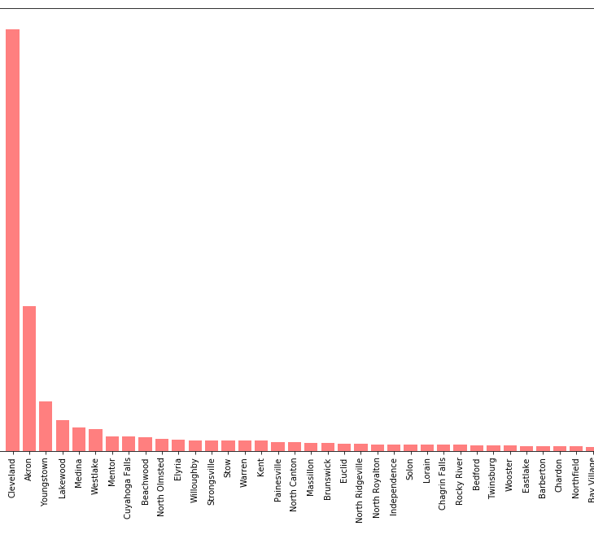
Which cities are the most active?
Cleveland was by far the greatest participation, with over 14,000 users. This was almost 3x the next highest amount

Slide 10
What does the data tell us about participation?
On average, in the Cleveland area, each meetup member subscribes to 6.6 groups.
Of the top 200 groups, the groups with the largest membership : Cleveland 20, 30 Club with 8,404 members
Smallest group in our data set was 19 members- Broken Trail Adventures,

Slide 11
So… why do people use meetup?
Our hypothesis was that people primarily use Meetup to meet other people- ie socializing. We also believed that professional networking and technology were also quite popular.
The data supported our hypothesis- socializing was18.52% of group categories. Outdoor & Adventure was second at 16.02%

Slide 12
So… what else did you learn about meetup?
We also assumed there was a relationship between age of group (how long a group has existed) and its number of members. This would tell us about the life cycle of groups.
We expected to see older groups having more members

Slide 13
What does it all mean?
Using the robust Meetup API, we expected to find the answers to our many questions.
Overall, while the results confirmed our hypothesis- that is, people use Meetup for primarily social reasons. However, the data proved much more nuanced. While socializing was the leading category of group, it was only about 18% of total groups. The top four categories (outdoor adventure, business networking and tech) only made up 54% of total categories. This suggests that while socializing is a main reason why people go to Meetup groups, it is by far not the only one.
For some items, the data was either inconclusive or was not readily available. Our original question set addressed questions of evngaement (RSVP’s vs. actual headcount) that proved too difficult to obtain and we were unable to determine

